Slide 1
Государственное учреждение образования «Гудогайская средняя школа»
Дидактическая игра по английскому языку на тему «Animals»
Для 3—4 классов
Работу выполнила:
Мальдис Мария Олеговна
Учитель английского языка

Slide 2
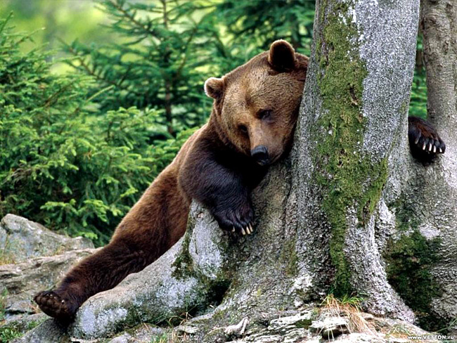
BEAR
crossword

Slide 3
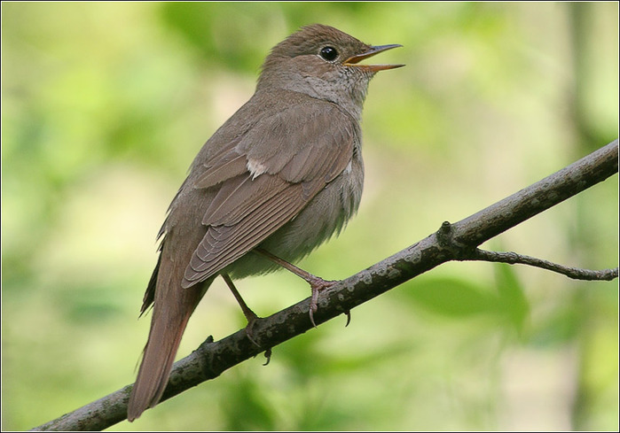
BIRD

Slide 4
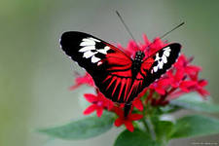
BUTTERFLY

Slide 5
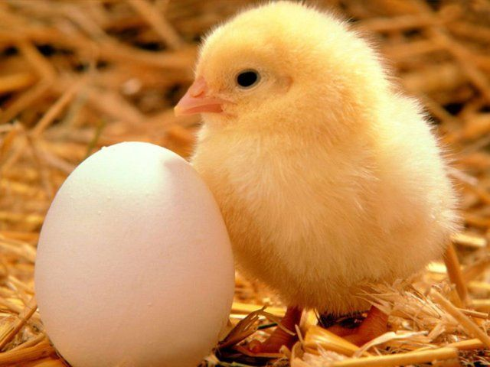
CHICKEN

Slide 6
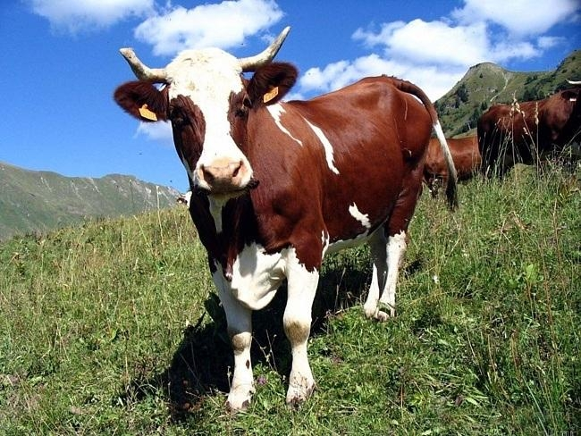
COW

Slide 7
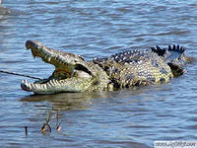
CROCODILE

Slide 8
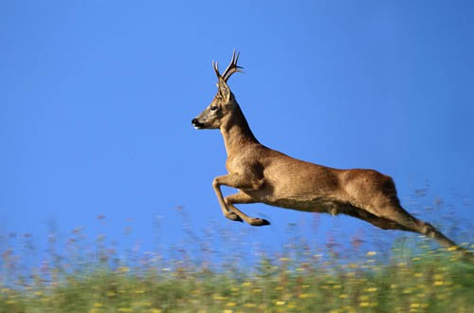
DEER

Slide 9
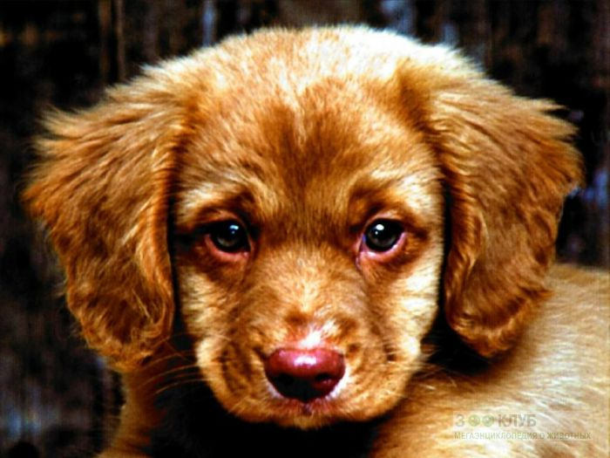
DOG

Slide 10
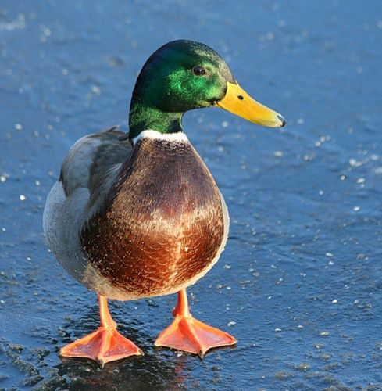
DUCK

Slide 11
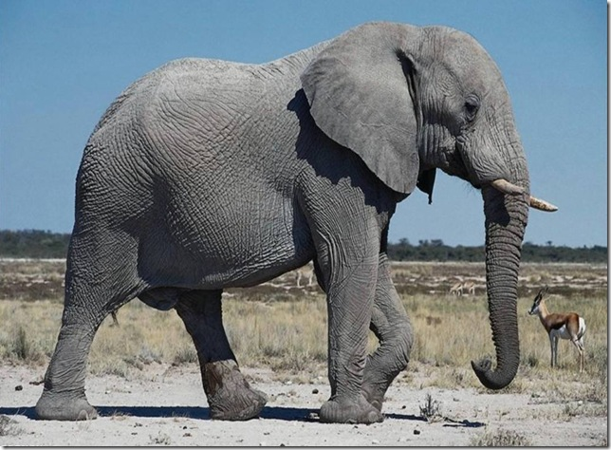
crossword
ELEPHANT

Slide 12
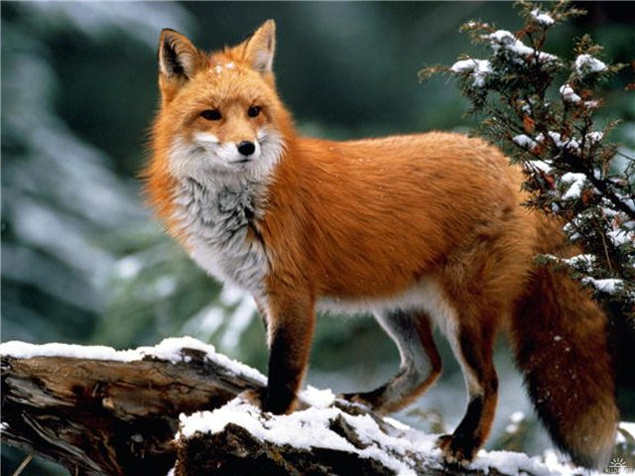
FOX

Slide 13
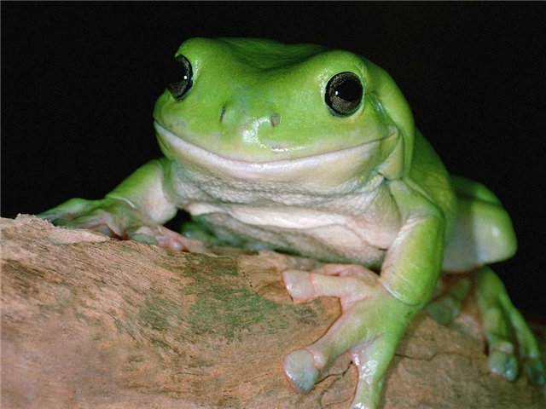
FROG

Slide 14
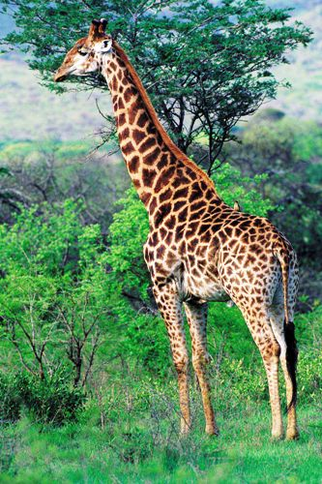
GIRAFFE

Slide 15
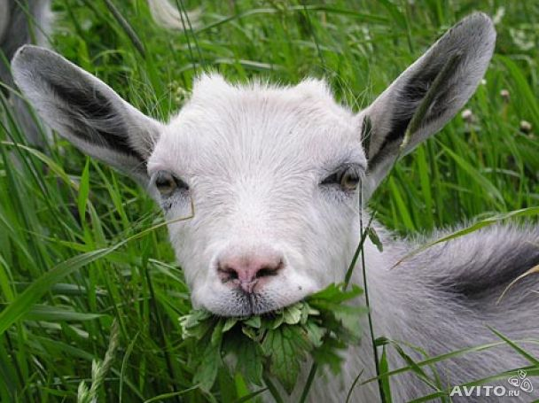
GOAT

Slide 16
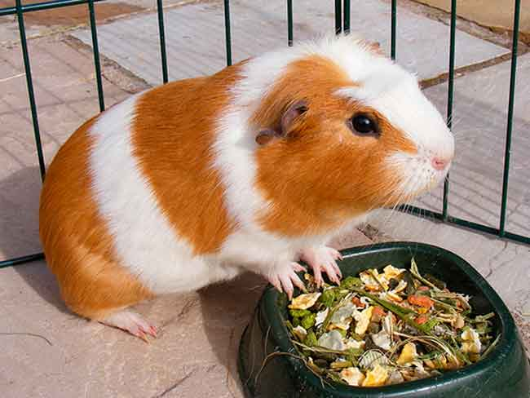
GUINEA-PIG

Slide 17
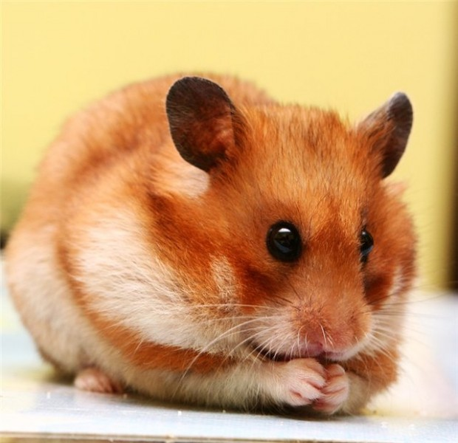
HAMSTER

Slide 18
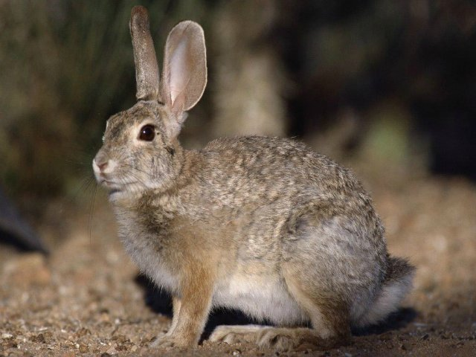
HARE

Slide 19
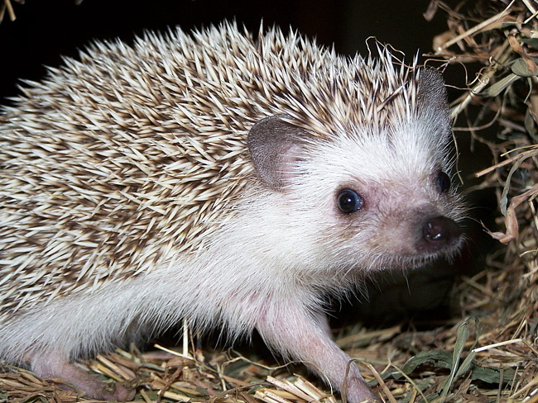
HEDGEHOG

Slide 20
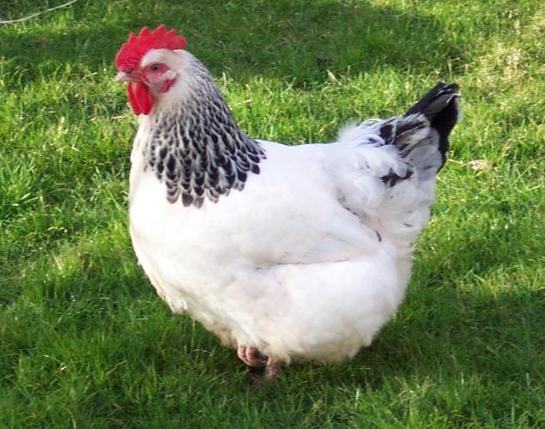
HEN

Slide 21
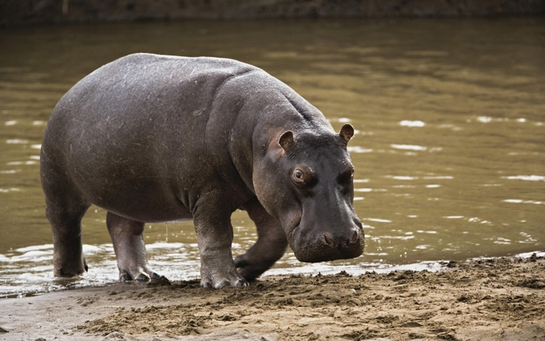
HIPPO

Slide 22
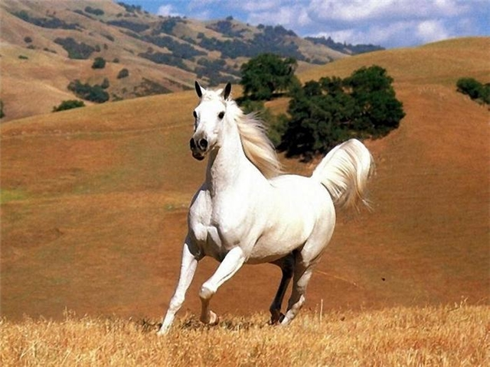
HORSE

Slide 23
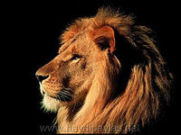
LION

Slide 24
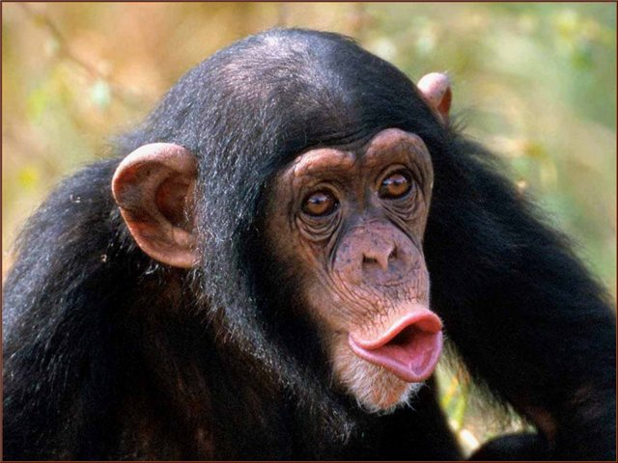
MONKEY

Slide 25
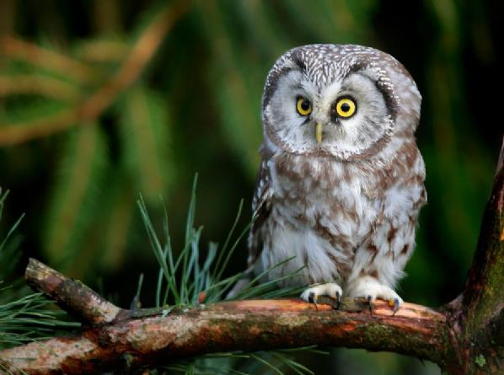
OWL

Slide 26
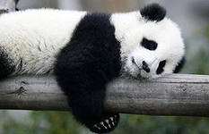
PANDA

Slide 27
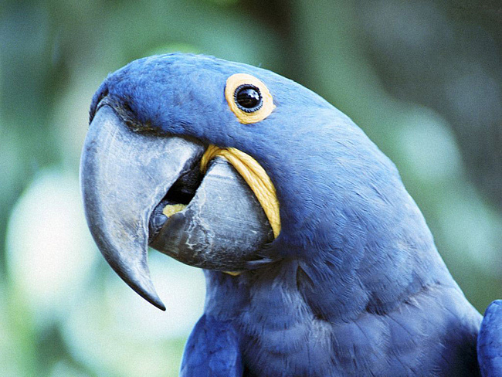
PARROT

Slide 28
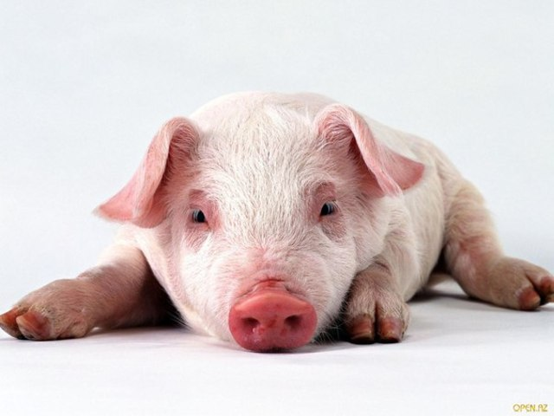
PIG

Slide 29
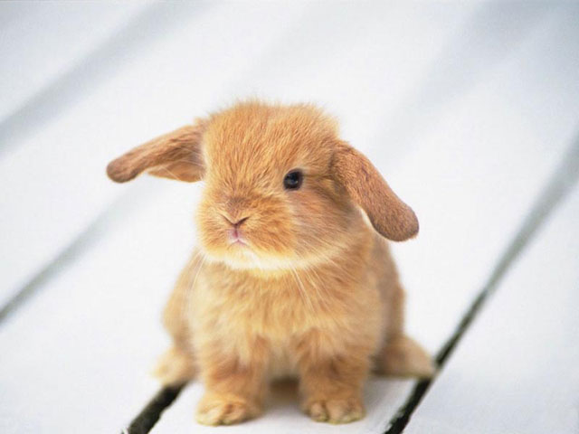
RABBIT

Slide 30
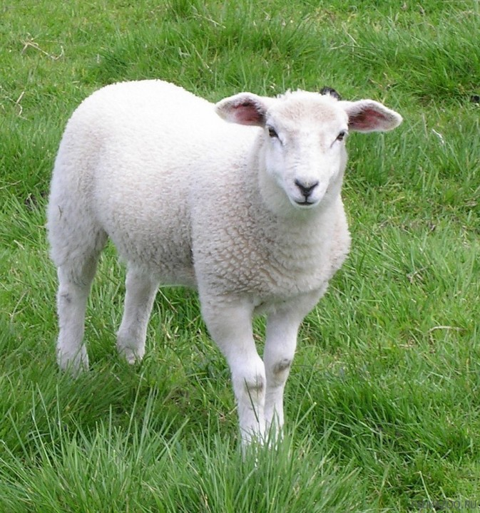
SHEEP

Slide 31
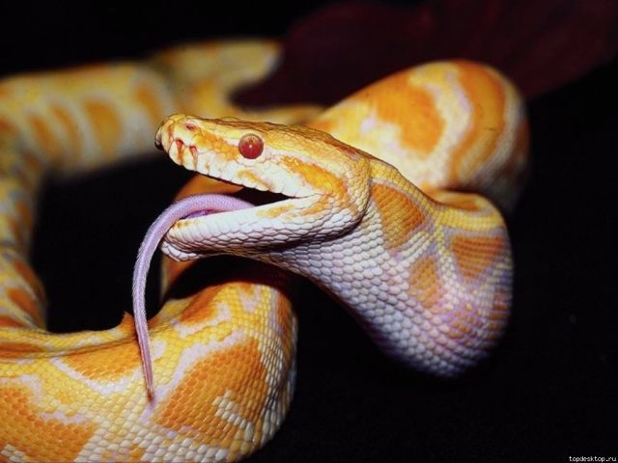
SNAKE

Slide 32
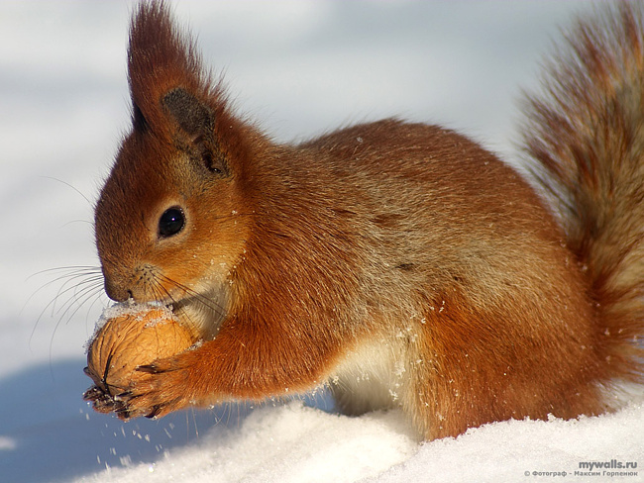
SQUIRREL

Slide 33
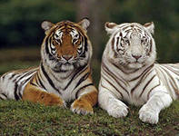
TIGER

Slide 34
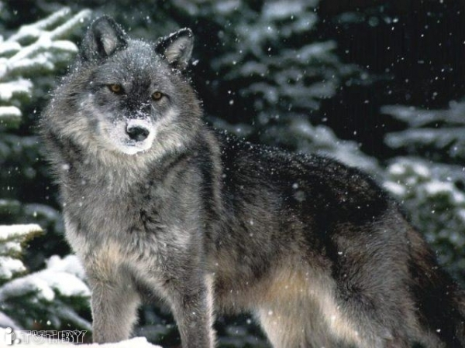
WOLF

Slide 35
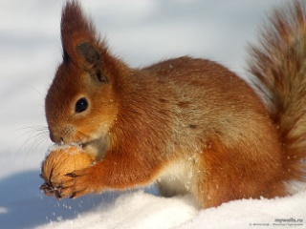
The first task
RABBIT
GUINEA-PIG
SQUIRREL
GOAT

Slide 36
The second task Guess the riddle
This animal is small. It lives in the forest. It’s grey or white. It runs very fast and it is afraid of everything. It likes carrot.
It is big and grey. His nose is long. His tail is short. He lives in the jungle. He likes vegetables , leaves, grass, fruits
It’s a big animal. It eats grass and gives milk.
It’s big and brown. It sleeps in winter. It likes honey.
It’s green. It can swim and jump. It likes to eat flies.

Slide 37
The third task
The funniest animal in the world.
It likes bananas very much.

Slide 38
It’s very, very big.
It likes to eat peanuts and hay.
It has four legs and two big ears.
His long nose is called a trunk.

Slide 39
It lives in the woods.
It’s very big and furry.
It has a big nose, a little tail and four legs.
It likes to eat fish and berries.

Slide 40
It lives in lakes and rivers.
It eats fish and birds.
It has four legs and a long tail.
It has lots of pretty teeth.

Slide 41
BU _TER_LY
CH_CKE_
GIR_ _F_
_EDG_HOG
TI_ER
The fourth task
Fill in the missing letters

Slide 42
ODG
RDEE
EEPHS
ANPAD
WFLO
SEAKN
The fifth task
Unscramble letters and write the name of the animal

