Slide 1
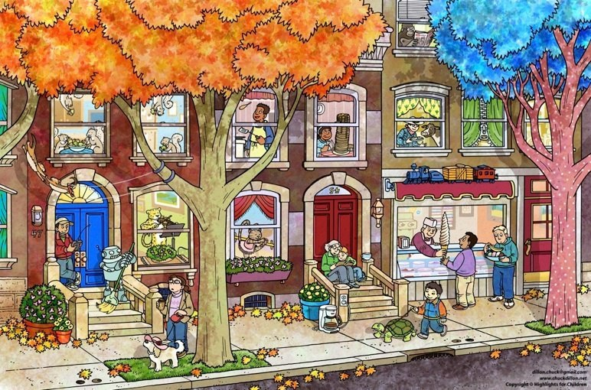
9

Slide 2
model
Is she eating the pancakes?
(9)

Slide 3
5
1
4
2
2
7
3
6
8

Slide 4
keys
Are squirrels eating?
Is tiger playing the violin?
Is he watching the film?
Is he cooking the pancake?
Is he reading ?
Is she dancing?
Is he giving the ice cream?

