Slide 1
Warm-up

Slide 2
What’s this? What color is it?

Slide 3
What’s this? What color is it?

Slide 4
What’s this? What color is it?

Slide 5
What subject is it? What do we do in this lesson?

Slide 6
What subject is it? What do we do in this lesson?

Slide 7
What subject is it? What do we do in this lesson?

Slide 8
What subject is it? What do we do in this lesson?

Slide 9
How do you spell 1st?
F i r s t
_____ ______ _______ _______ _______

Slide 10
How do you spell 4th?
F o u r t h
_____ ______ _____ ______ ______ ______

Slide 11
How do you spell 6th?
S i x t h
_____ _____ ______ ______ ______

Slide 12
How do you spell 3d?
T h i r d
______ _____ ______ ______ ______

Slide 13
How do you spell 2d?
S e c o n d
______ ______ ______ ______ _____ ____

Slide 14
What are they doing?

Slide 15
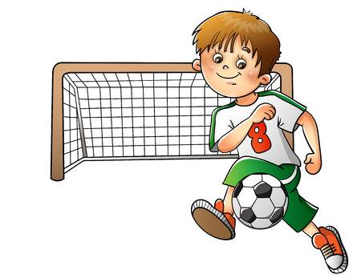
What is he doing?

Slide 16
What is she doing?

Slide 17
What are they doing?

Slide 18
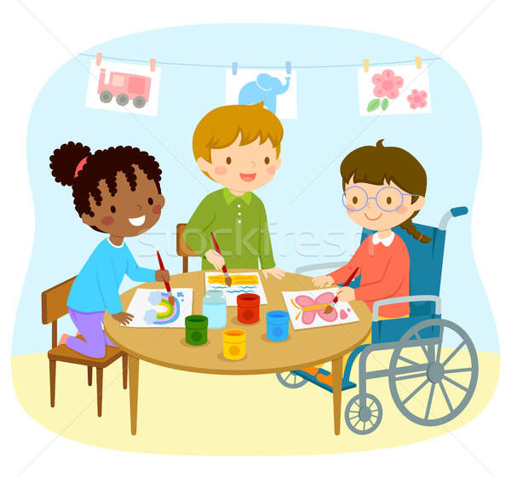
What are they doing?

Slide 19
What is he doing?

Slide 20
What is she doing?

Slide 21
Good luck

