Slide 1
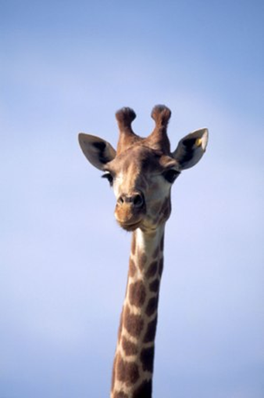
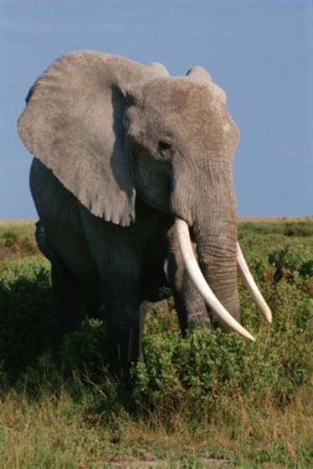
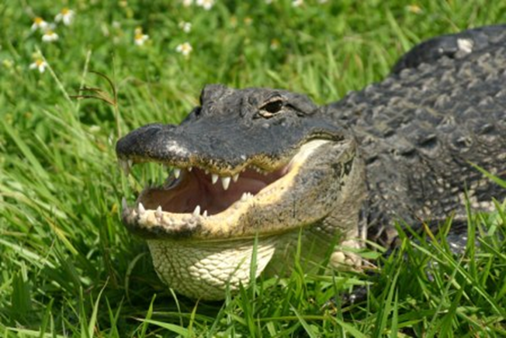
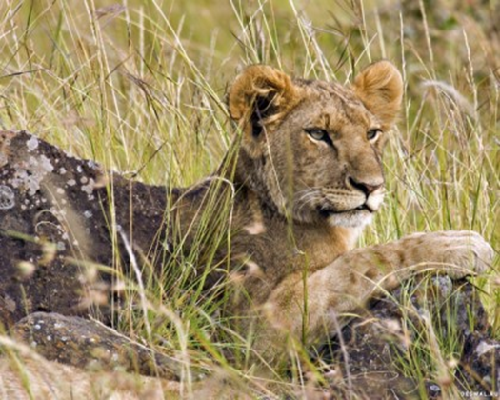
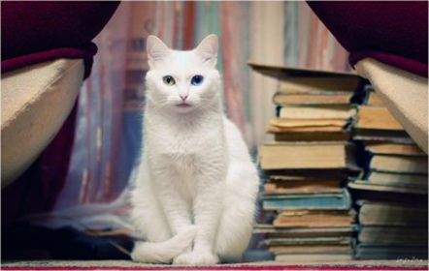
ANIMALS AND BIRDS

Slide 2
My dear cat,
Sleeps in the hat
The hat is tall
The cat is small.
Little mouse , little mouse
Left her flat for bigger house
There are ten rooms in it
Where can the mouse sit?

Slide 3
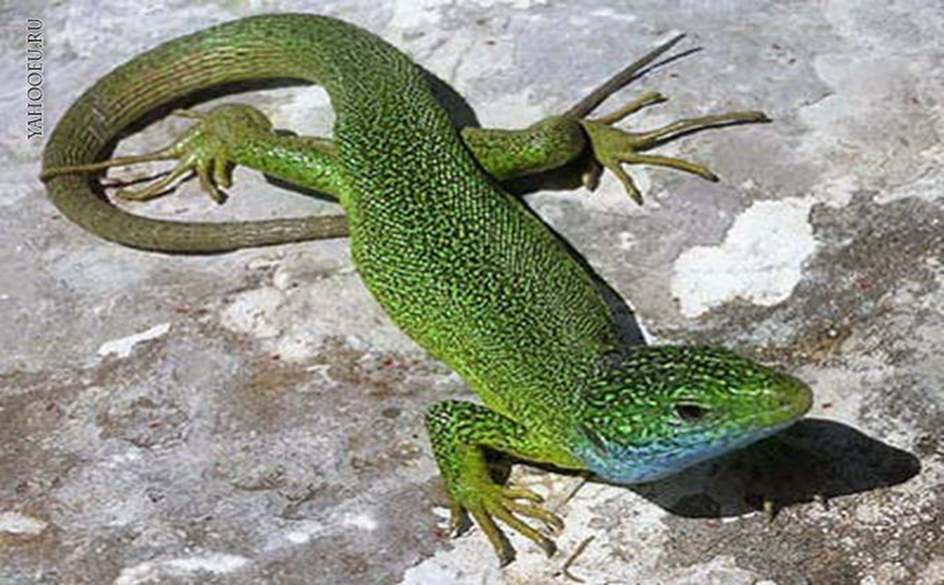
A lizard

Slide 4
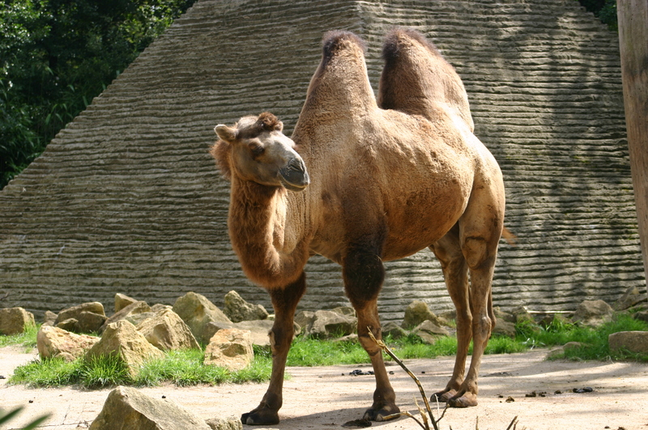
A camel

Slide 5
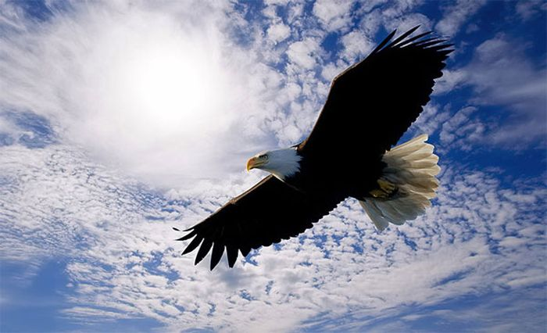
An eagle

Slide 6
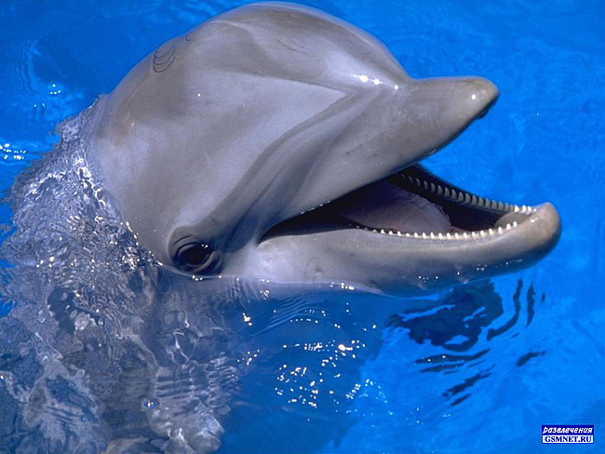
A dolphin

Slide 7
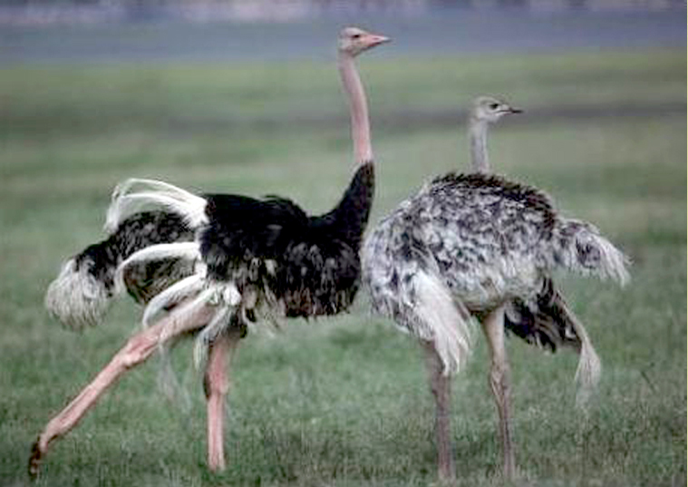
An ostrich

Slide 8
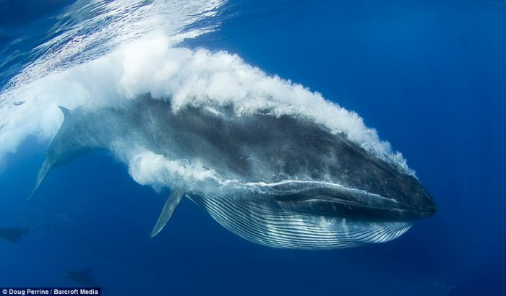
A whale

Slide 9
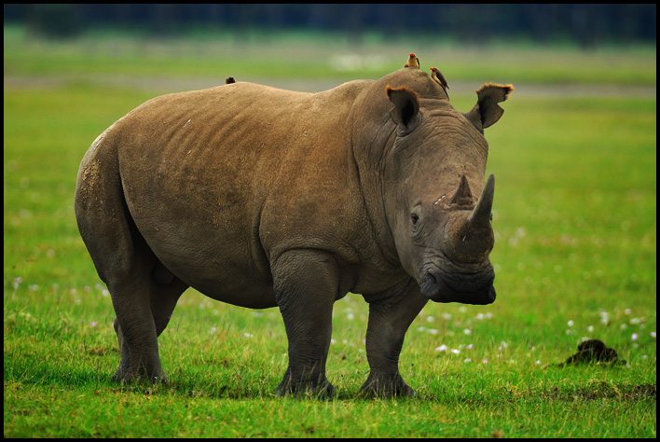
A rhino

Slide 10
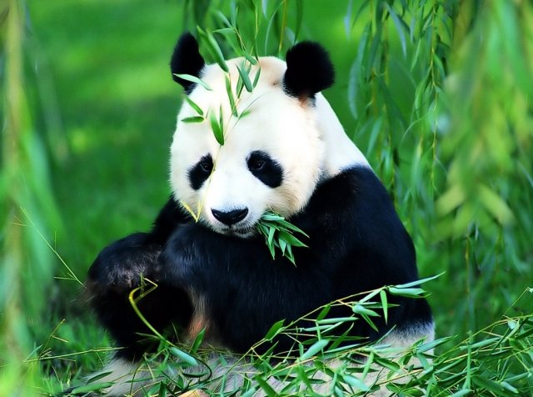
A panda

Slide 11
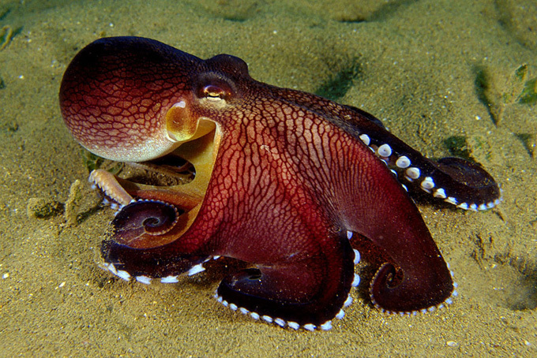
An octopus

Slide 12
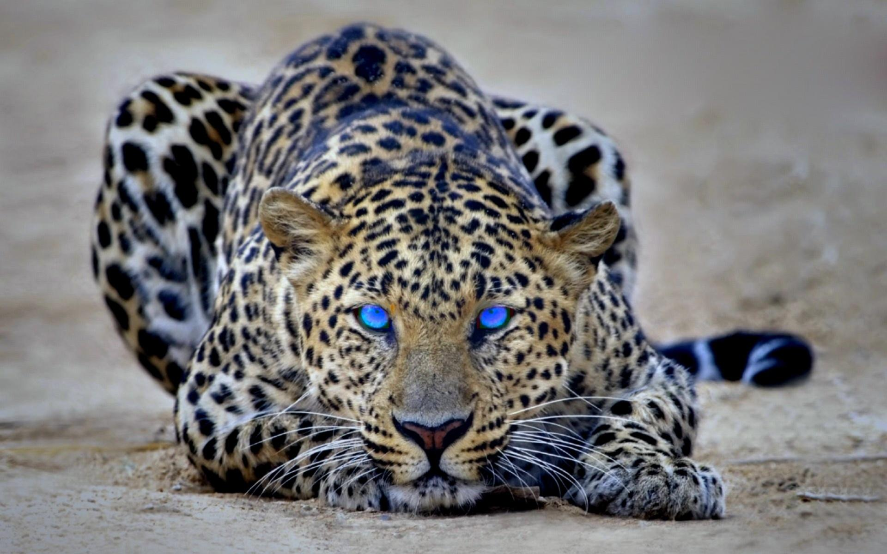
A cheetah

Slide 13
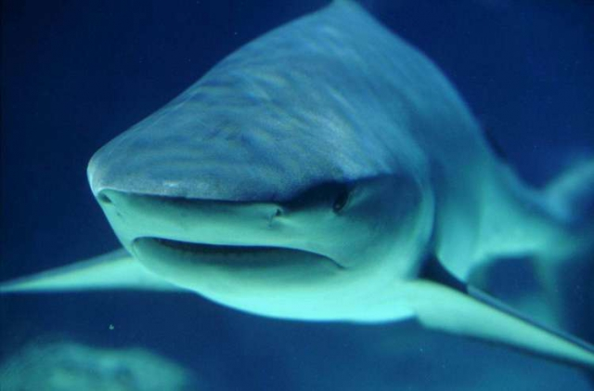
A shark

Slide 14
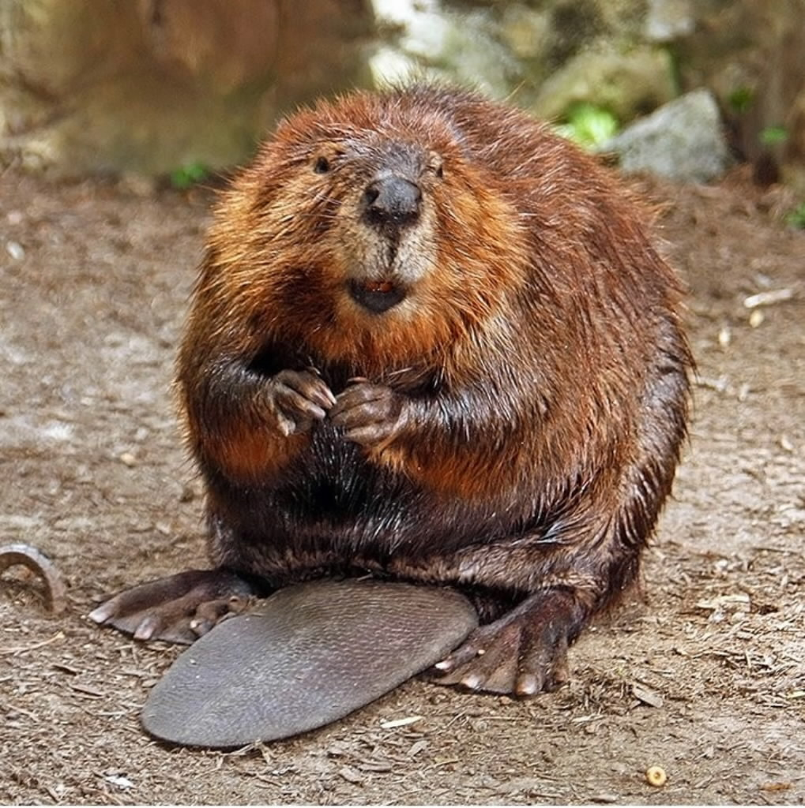
A beaver

Slide 15
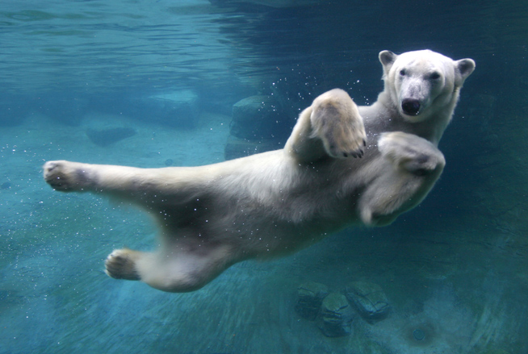
A polar bear

Slide 16
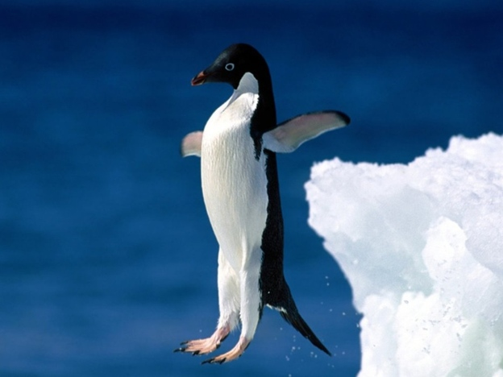
A penguin

Slide 17
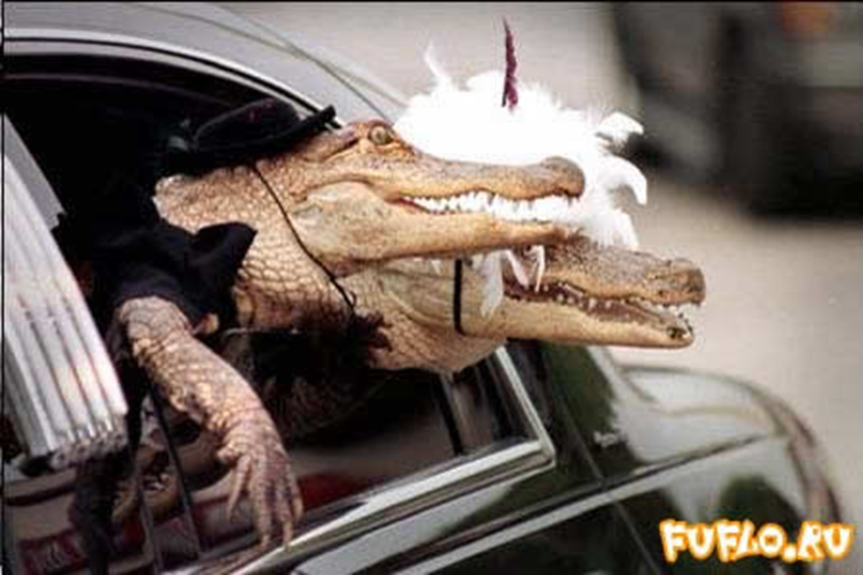
A crocodile

Slide 18
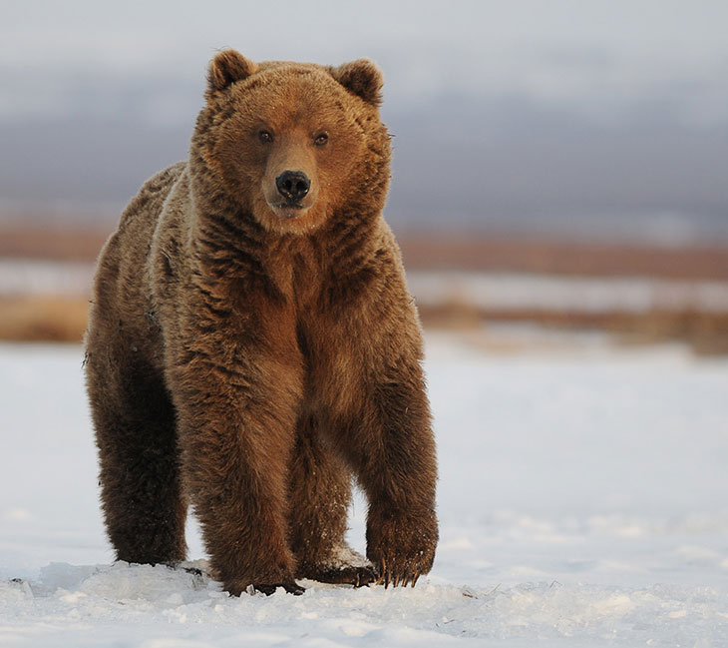
A bear

Slide 19
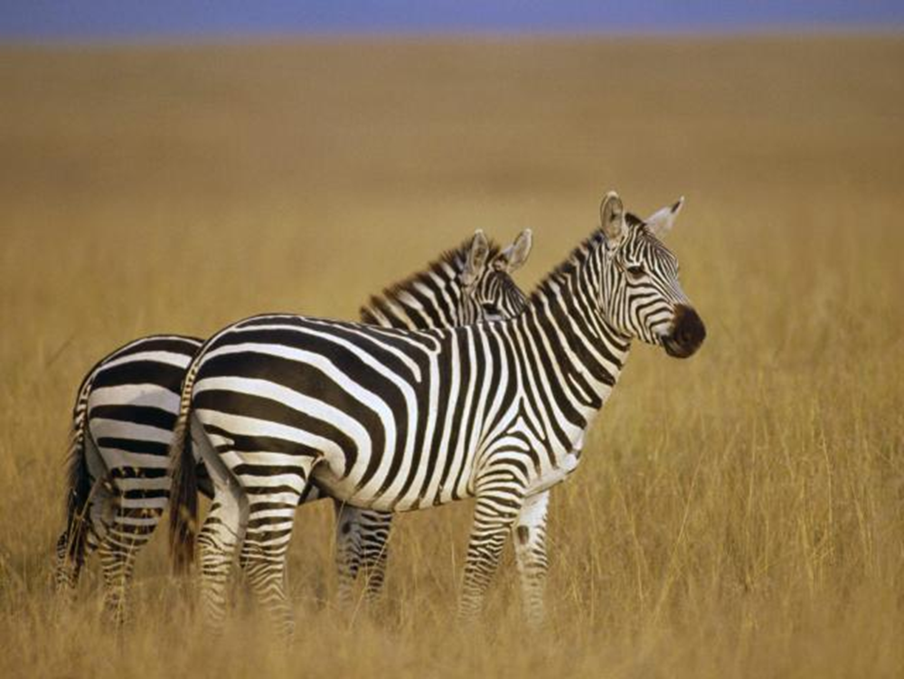
A zebra

Slide 20
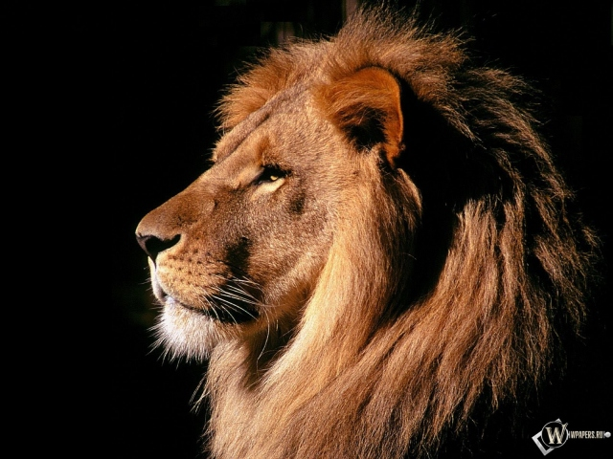
A lion

Slide 21
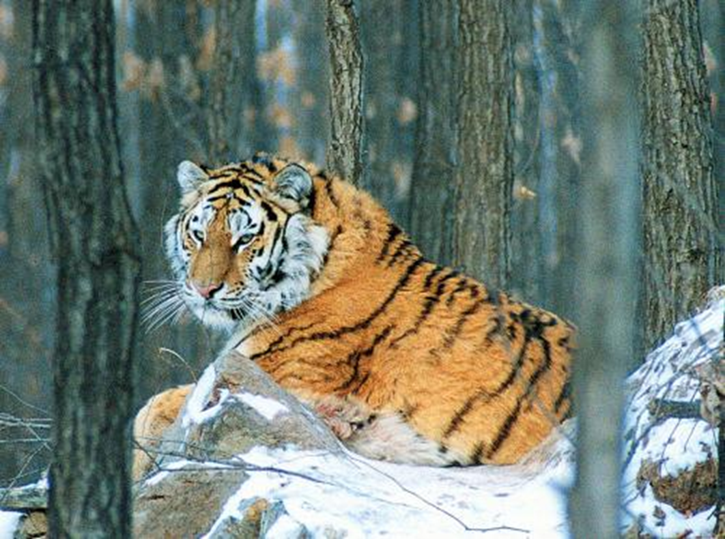
A tiger

Slide 22
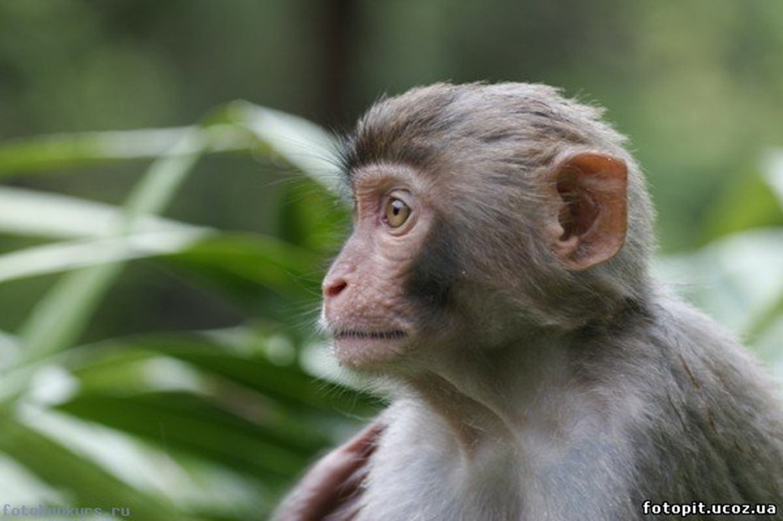
A monkey

Slide 23
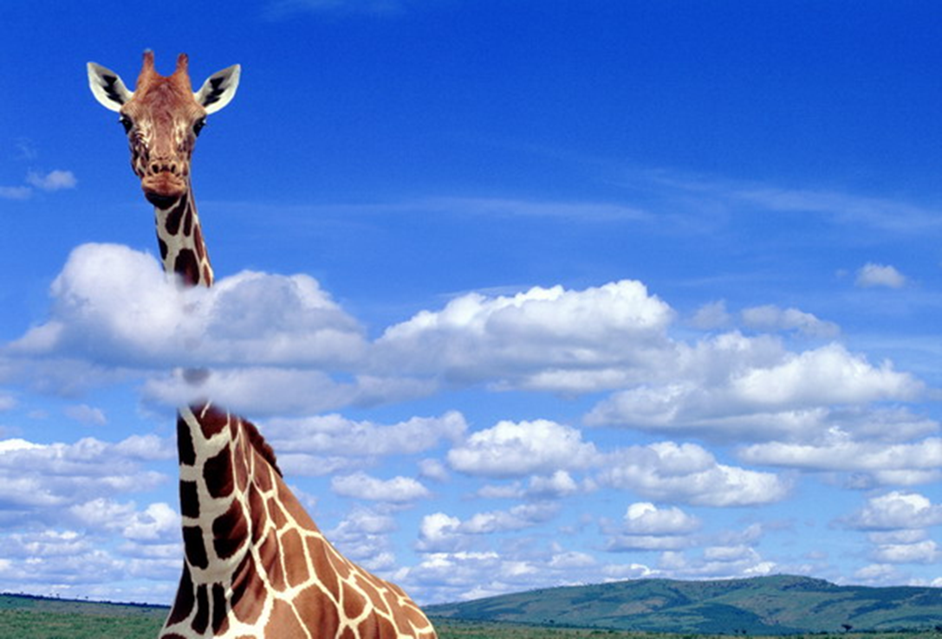
A giraffe

Slide 24
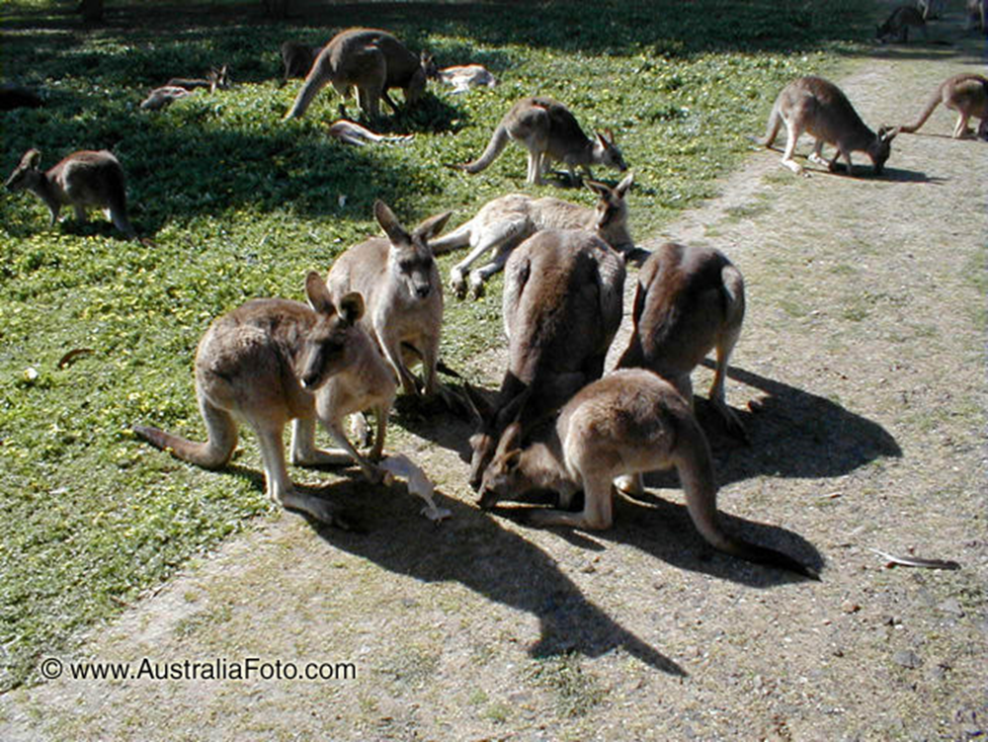
A kangaroo

Slide 25
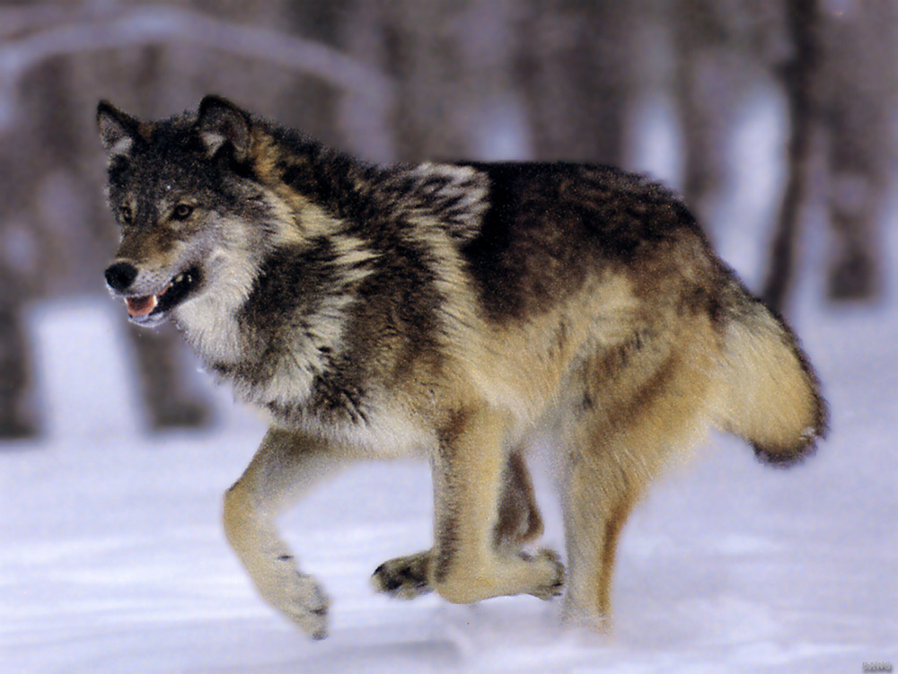
A wolf

Slide 26
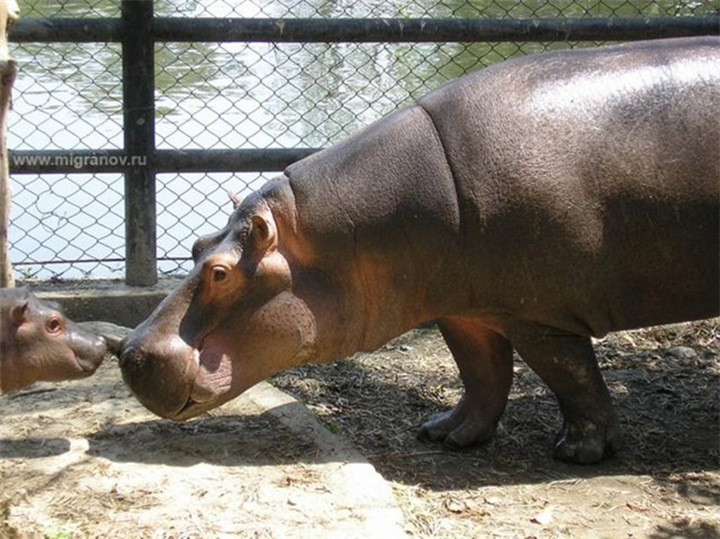
A hippo

Slide 27
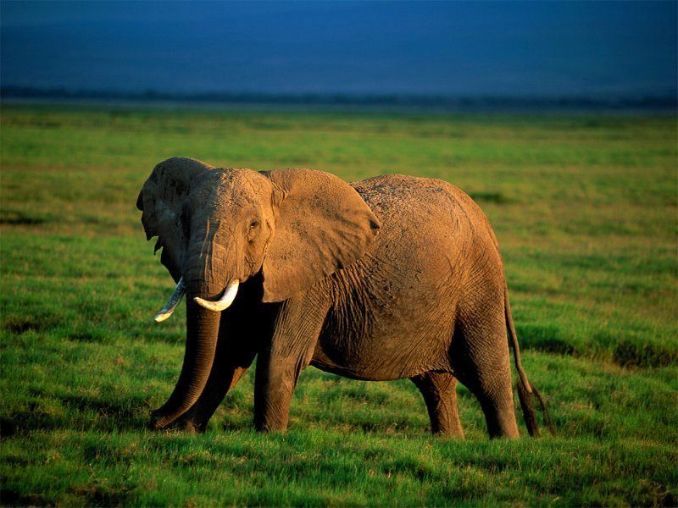
An elephant

Slide 28
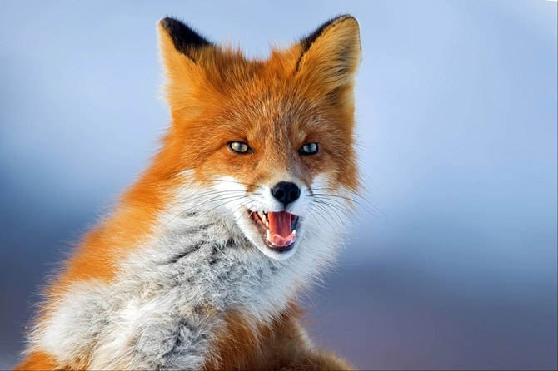
A fox

Slide 29
TASK 1

Slide 30

ZEBRA

Slide 31
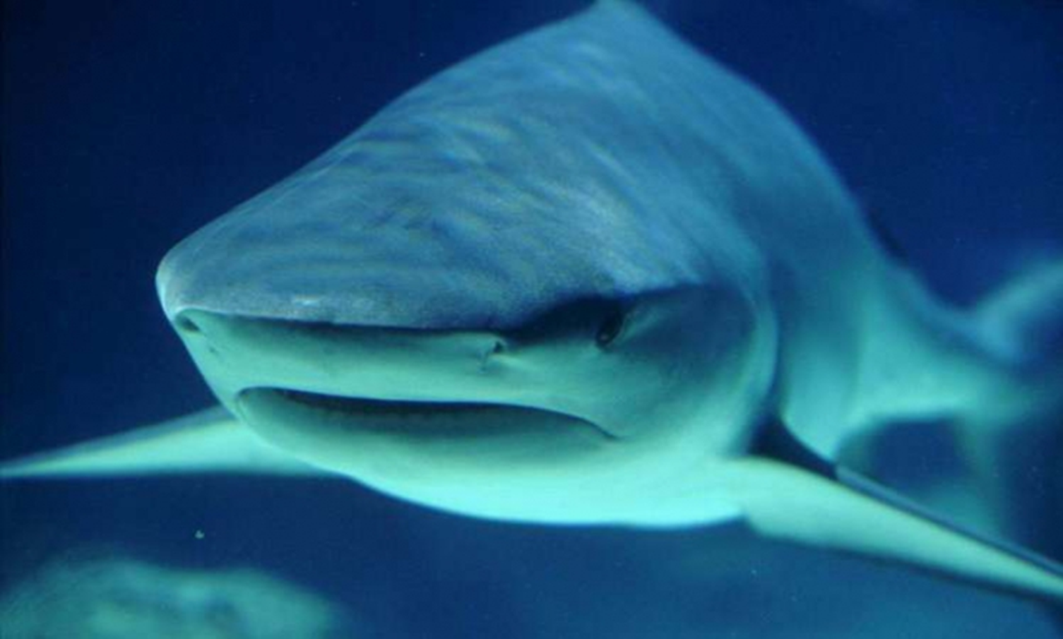
SHARK

Slide 32

ELEPHANT

Slide 33
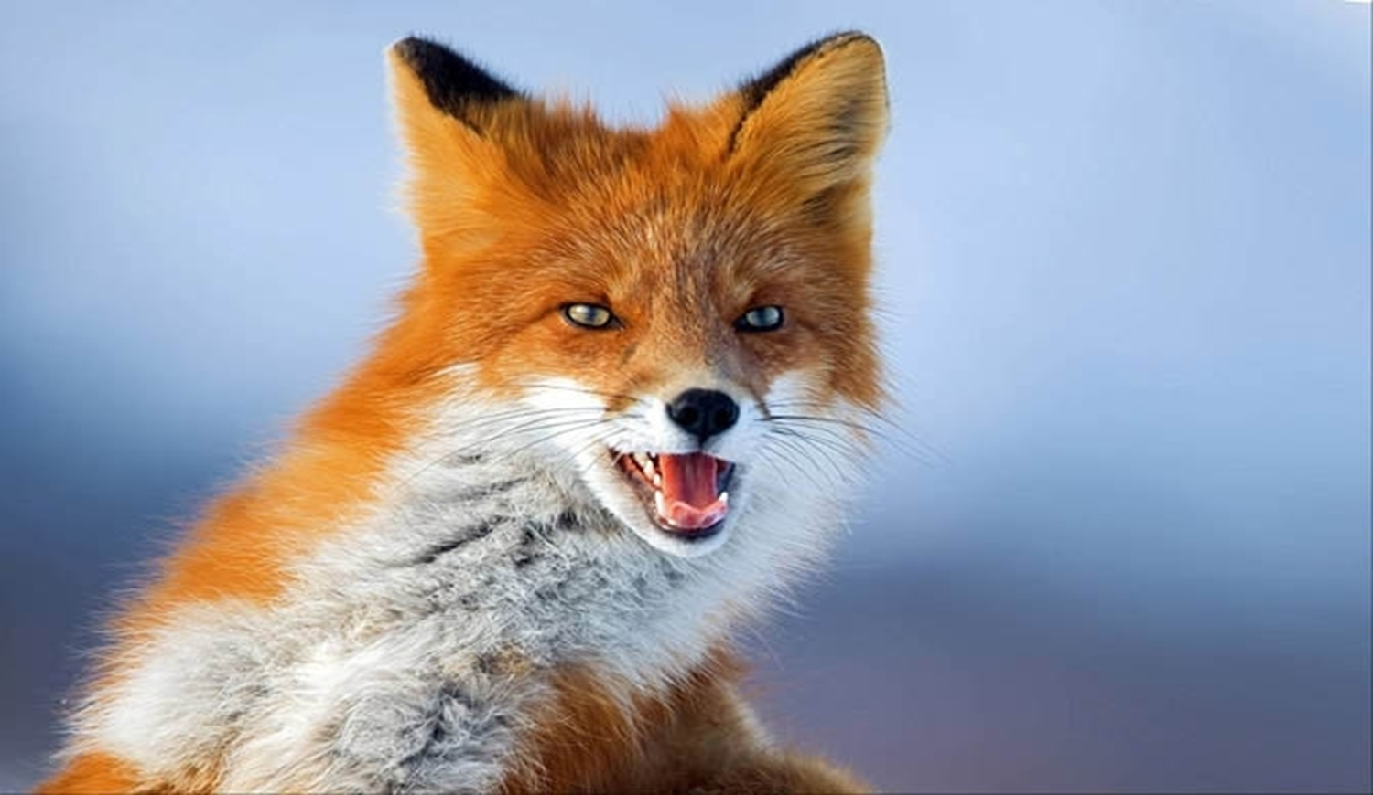
FOX

Slide 34

TIGER

Slide 35

BEAR

Slide 36

LIZARD

Slide 37

GIRAFFE

Slide 38
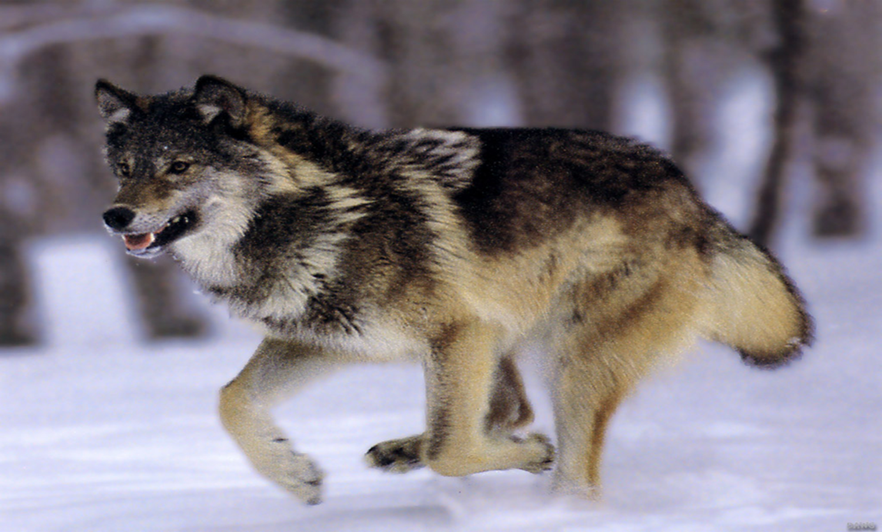
WOLF

Slide 39

LION

Slide 40
TASK 2

Slide 41
Lion bear dog fish
Monkey camel cat duck
Mouse cow snake
Tiger rabbit elephant pig

Slide 42
TASK 3

Slide 43
S
C H I C K E
N
D A
A
G O A T
C
K
G
H O R S
E
H
W
B E
K I T T E N
R P
D

Slide 44
TASK 4

Slide 45
I think … live in….
1.kangaroo
2.an ostrich
3.whale
4.a dolphin
5.a shark
6.a camel
7.a cheetah
8.a koala
1.Africa
2.jungle
3.ocean
4.desert
5.mountain
6.grasslands
7.Australia
8.North America

Slide 46
Can you hop like a rabbit? (Yes, we can!)
Can you jump like a frog? (Yes, we can!)
Can you walk like a duck? (Yes, we can!)
Can you run like a dog? (Yes, we can!)
Can you fly like a bird? (Yes, we can!)
Can you swim like a fish? (Yes, we can!)
Can you be like a good child? (Yes, we can!)
As still as you wish? (Yes, we can!)

Slide 47
TASK 5

Slide 48
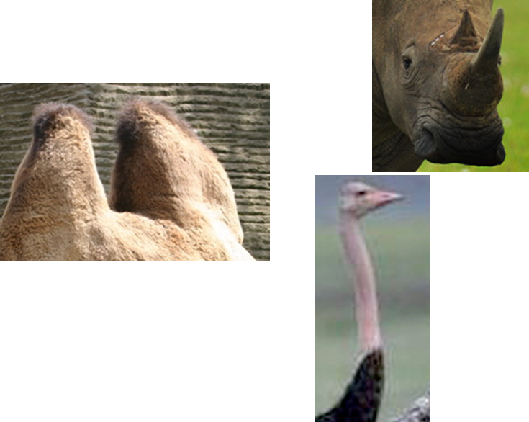

Slide 49
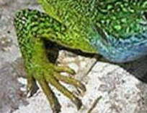
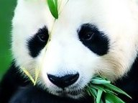
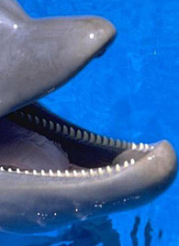

Slide 50
TASK 9

Slide 51
Bear crocodile cat chicken elephant cow dog fox duck frog hen giraffe horse hare kitten lion monkey parrot pappy snake zebra sheep

Slide 52
I’m glad to work with you!!!

