Slide 1
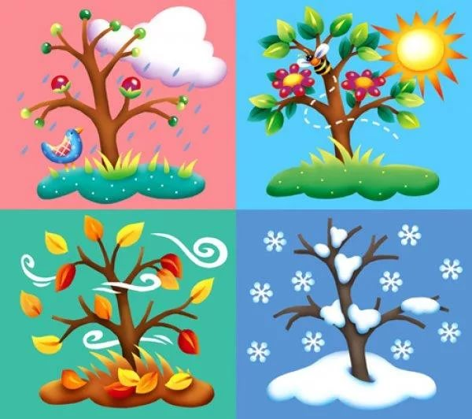
All seasons
are beautiful

Slide 3
Today we are going to…
Speak about weather
and seasons
read the text
ask and answer
the questions
do the tasks
write

Slide 4
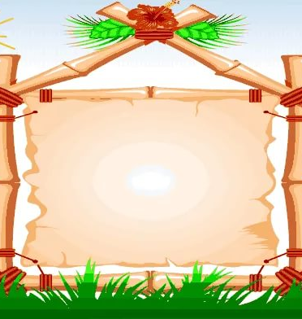
Match the words with the right house
windy
Fly
foggy
Ice-hockey
rainy
sunny
mouse
Bounty
house
Sky
nice
cloudy

Slide 5
Let’s check
mouse
Bounty
house
cloudy
sunny
foggy
rainy
windy
fly
nice
ice-hockey
sky

Slide 6
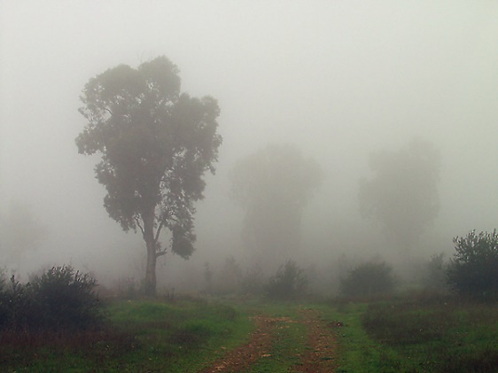
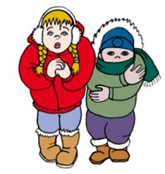
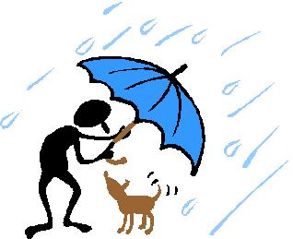
It’s …

Slide 7
Let’s play
-Is it …?
-No, it isn’t
-Yes, it is

Slide 8
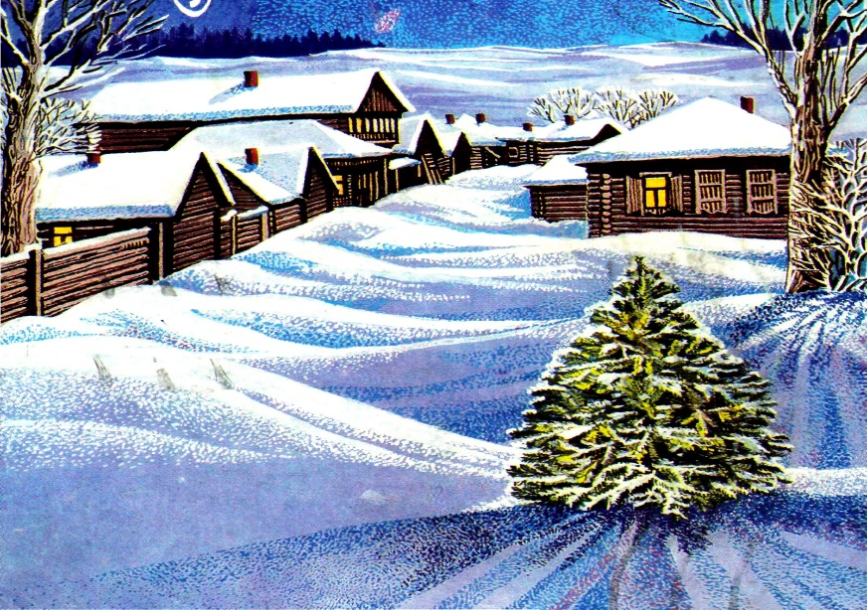
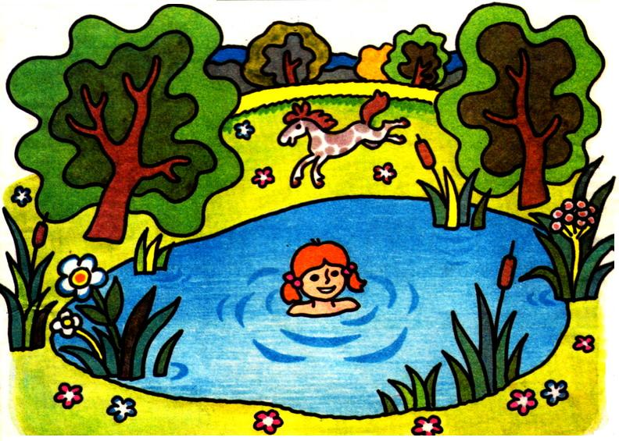
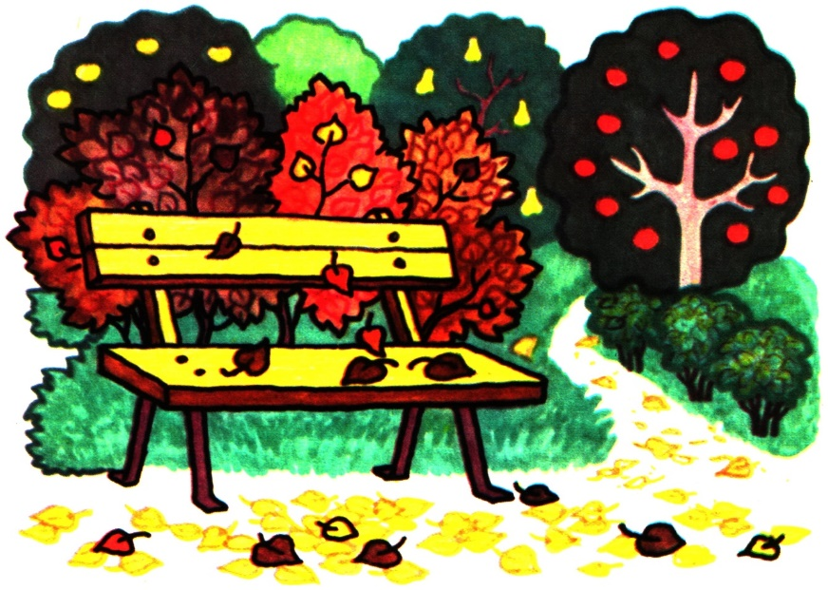
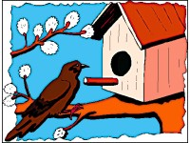
What season is it?

Slide 9
Let’s read

Slide 10
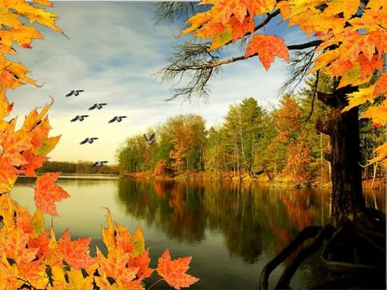
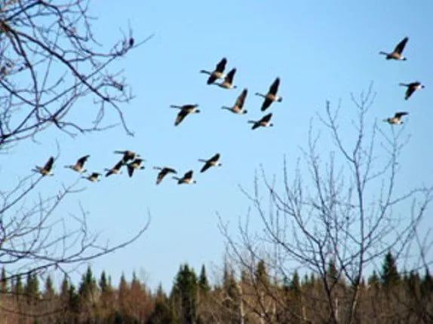
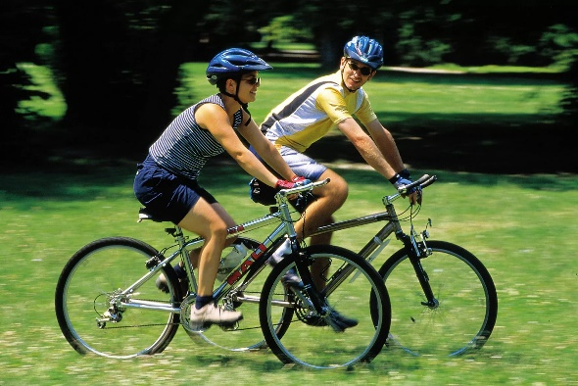
There are some unknown words
Fly away
Come back
Ride a bike

Slide 11
Match the weather and
the season
rainy
cold
snowy
hot
sunny
windy
warm
summer
winter
spring
autumn

Slide 12
Is it true or false?
It’s cold in summer.
I can play snowballs in summer.
It’s hot in winter.
It’s cloudy, foggy and rainy in autumn.
I can play football in spring.

Slide 13
Fill in the missing word or phrase
Winter, spring, summer and autumn are …
In winter I can play …, skate and ski.
In spring the weather is…
I … … … … in summer.
Birds … … in autumn.
In summer the trees are …

Slide 14
It’s time to have a little rest!

Slide 15
Fill in the missing letter and guess the word
se…son
h…t
sw…m
r…iny
sk…te
wa…m
w…nter
fog…y

Slide 16
Let’s check
season
hot
swim
rainy
skate
warm
winter
foggy

Slide 17
Find out 10 words on the topic “Seasons and weather”
S | N | O | W | Y | S | D | C | O | L | D | W | O | A
U | E | S | I | G | J | U | K | Y | J | E | I | L | U
M | S | U | N | N | Y | A | O | A | Z | C | N | N | T
M | W | Q | D | E | R | A | U | L | E | S | T | M | U
E | X | T | Y | I | P | L | D | A | R | M | E | U | M
R | A | I | N | Y | S | D | Y | D | S | B | R | A | N
A | H | O | T | Z | M | A | N | C | H | B | J | N | U

Slide 18
Let’s check
S | N | O | W | Y | S | D | C | O | L | D | W | O | A
U | E | S | I | G | J | K | L | Y | J | E | I | L | U
M | S | U | N | N | Y | A | O | A | Z | C | N | N | T
M | W | Q | D | E | R | A | U | L | E | S | T | M | U
E | X | T | Y | I | P | L | D | A | R | M | E | U | M
R | A | I | N | Y | S | D | Y | D | S | B | R | A | N
A | H | O | T | Z | M | A | N | C | H | B | J | N | U

Slide 20
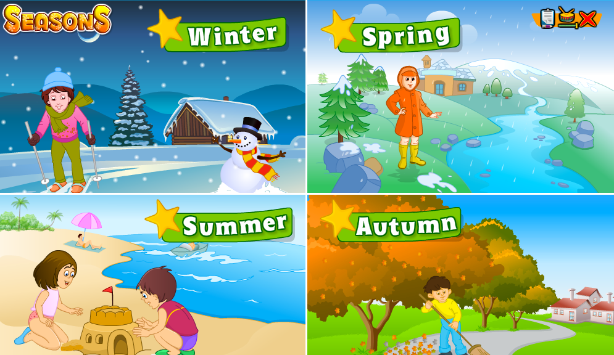

Slide 21
Did you like the lesson?

Slide 22
Thank you for your work!
Good-bye!

